Slide 1

BASIC PRESENTATION

Slide 2

Objectives
Company Overview: AtliQ Hardware, a leading computer hardware manufacturer in India, has a significant presence in international markets.
Current Challenge: Management has identified a lack of sufficient insights for making prompt, wise, and data-informed decisions.
Expansion Plan: To address this, the company plans to expand its data analytics team by hiring junior data analysts.
Assessment Strategy: Tony Sharma, the Data Analytics Director, will conduct an SQL challenge to evaluate candidates' technical and soft skills.
Goal: The company aims to gain insights from 10 ad hoc data requests.

Slide 3
Company Detail
Fiscal Year
September 2019 – August 2020
FY 2020
September 2020 – August 2021
FY 2021
PC
Desktop
Business laptop
Personal laptop
Notebook
Gaming Laptop
Business laptop
Personal laptop
N & S
Networking
Storage
WI Fi Extender
External SSD
USB Flash drives
P & A
Graphic card
Internal HDD
Accessories
Batteries
Keyboard
Mouse
Peripherals
MotherBoard
Processors
DIvision
Segment
category

Slide 4
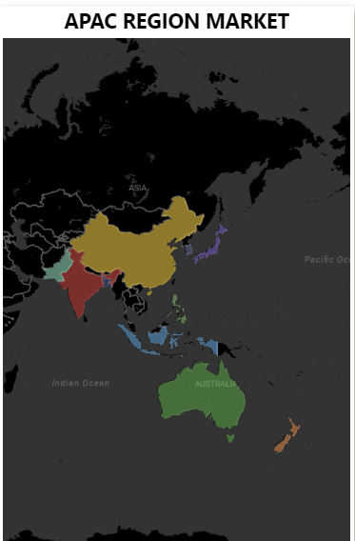
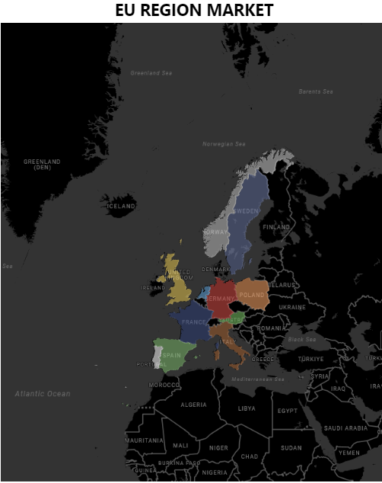
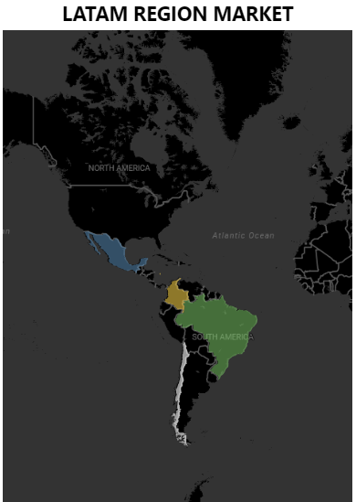
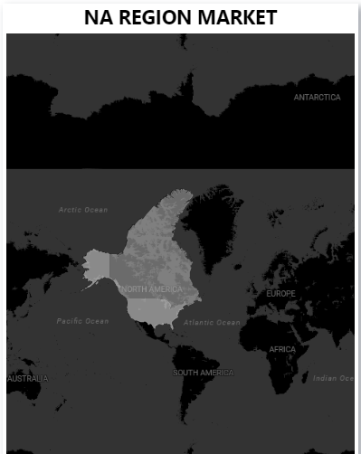
Company`s Market

Slide 5
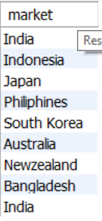
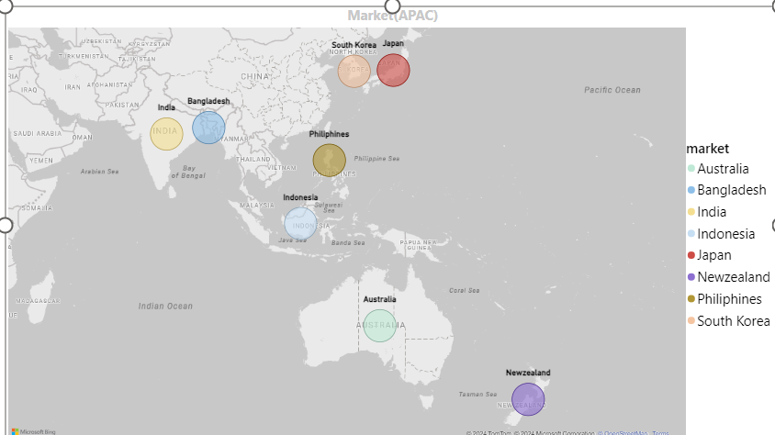

1. Provide the list of markets in which customer "Atliq Exclusive" operates its business in the APAC region. 2.
AD-Hoc requests

Slide 6
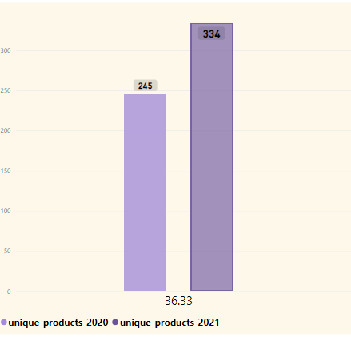
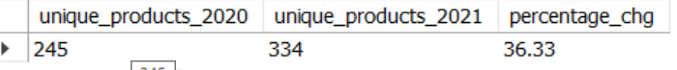
What is the percentage of unique product increase in 2021 vs. 2020? The final output contains these fields, unique_products_2020
unique_products_2021
percentage_chg
36.33% increase
Insights
Product increased by 36.33% in the year 2021 as compared to 2020.

Slide 7
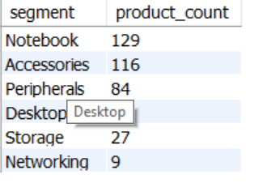
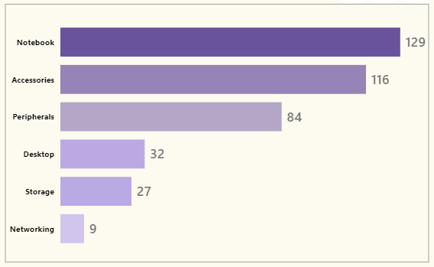
Provide a report with all the unique product counts for each segment and sort them in descending order of product counts.
The final output contains 2 fields,
segment
product_count
Unique product count for each segment
83%
Segments: Notebooks, accessories, and peripherals are experiencing significant manufacturing growth compared to desktops, storage, and networking.
Manufacturing Share: Notebooks, accessories, and peripherals make up 83% of the total manufactured products.

Slide 8
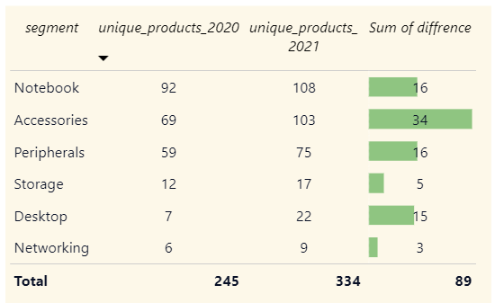
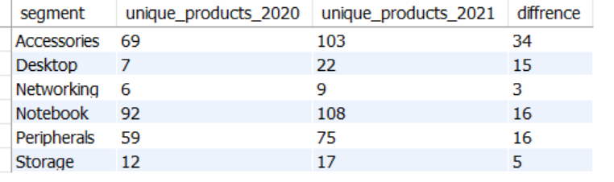
Which segment had the most increase in unique products in 2021 vs 2020? The final output contains these fields, segment
product_count_2020
product_count_2021
difference
Unique product difference per segment from 2020 to 2021
Production of accessories has seen the largest increase.
Production growth in storage and networking is slower compared to other segments.

Slide 9


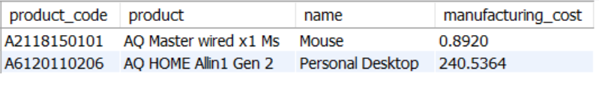



Get the products that have the highest and lowest manufacturing costs. The final output should contain
these fields,
product_code
product
manufacturing_cost
Mouse have the
lowest manufacturing
costs 0.829
Personal Desktop has the highest manufacturing cost
240.54
Mouse: The AQ Master Wired XI Ms (Standard 1) is the most cost-effective to manufacture.
Personal Desktop: The AQ Home Allini Gen2 (Plus 3) is the most expensive to manufacture.

Slide 10
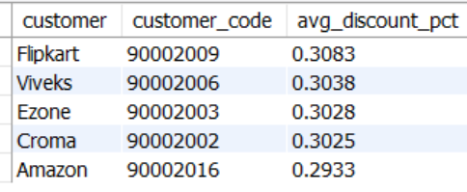
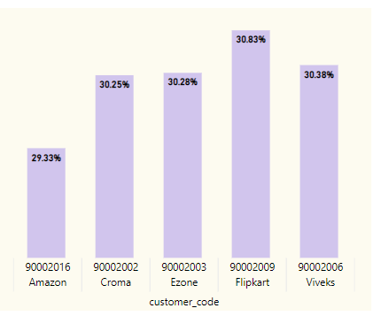
Generate a report which contains the top 5 customers who received an average high pre_invoice_discount_
pct for the fiscal year 2021 and in the Indian market. The final output contains these fields,
customer_code
customer
average_discount_percentage
Top 5 Indian customers with average discount percentage for FY 2021
Flipkart: Received the largest average pre-invoice discount.
Amazon: Received the least average pre-invoice discount.

Slide 11
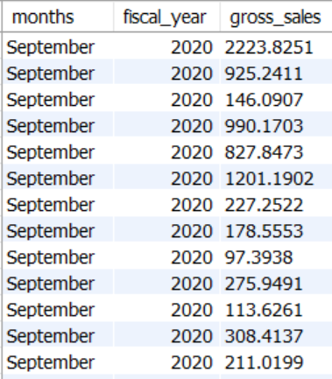
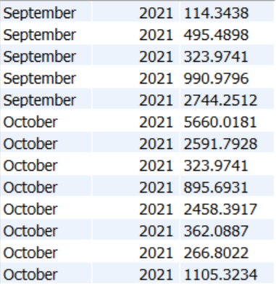
Get the complete report of the Gross sales amount for the customer “Atliq Exclusive” for each month .
This analysis helps to get an idea of low and high-performing months and take strategic decisions.
The final report contains these columns:
Month
Year
Gross sales Amount
FY 2020
79.5M
Insights
Lowest Gross Sales: March 2020 recorded the lowest gross sales total across both fiscal years.
Highest Gross Sales: November 2020 recorded the highest gross sales total across both fiscal years.
Fiscal Year 2021: 73.8% of the total gross sales occurred in FY 2021.
FY 2021
224.4M

Slide 12
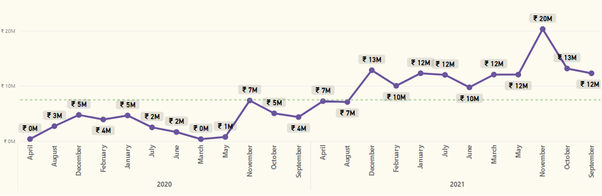
highest gross sales
Average line
Lowest gross sales

Slide 13
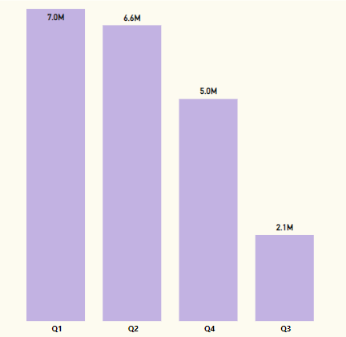
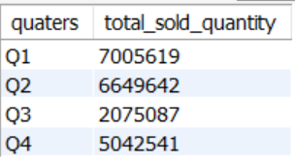
In which quarter of 2020, got the maximum total_sold_quantity? The final output contains these
fields sorted by the total_sold_quantity,
Quarter
total_sold_quantity
Total sold quantity by quarters for fiscal year 2020
Quarterly Sales: Quarter 1 of FY2020 recorded the highest units sold, while Quarter 3 had the lowest.
Sales Contribution: Quarter 1 accounted for about 34% of the total units sold in FY2020.

Slide 14
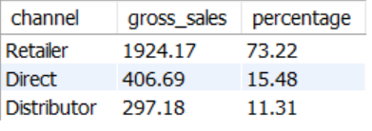
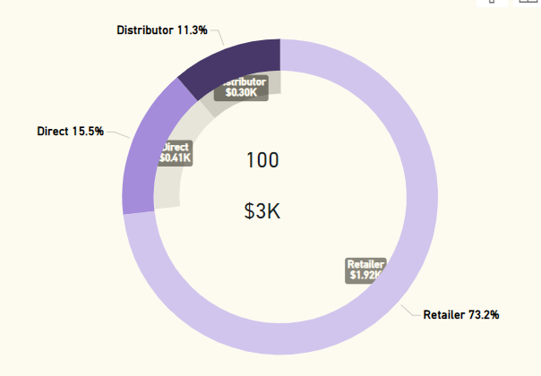
Which channel helped to bring more gross sales in the fiscal year 2021 and the percentage of contribution?
The final output contains these fields
, channel
gross_sales_mln
percentage
Gross sales and channel contribution by channel for fiscal year 2021
Top Sales Channel: "Retailer" was the top contributor, making up 73.2% of total sales.
Least Contribution: "Distributor" had the lowest contribution, accounting for 11.3% of total sales.
Total Sales: $406.69 million.

Slide 15
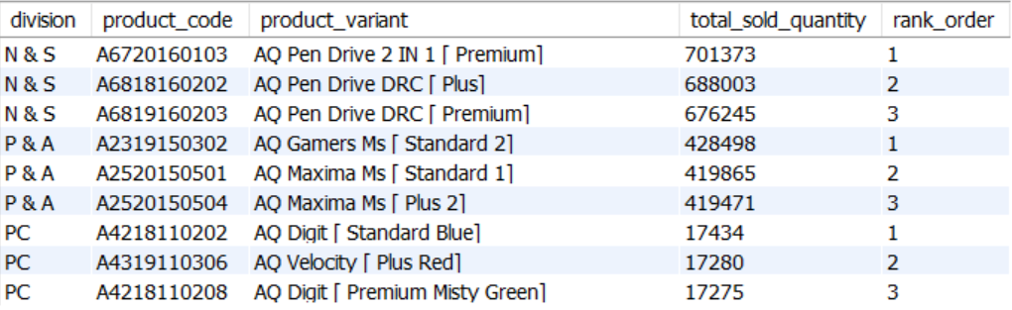
Get the Top 3 products in each division that have a high total_sold_quantity in the fiscal_year 2021?
The final output contains these fields,
division
product_code
product total_sold_quantity
rank_order
Insights
In every division, a product with different variants appears twice in the top three products list.

Slide 16
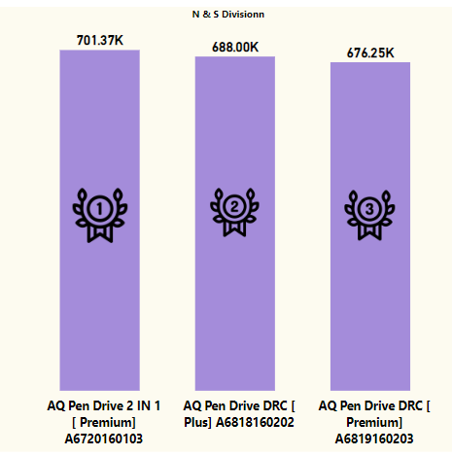
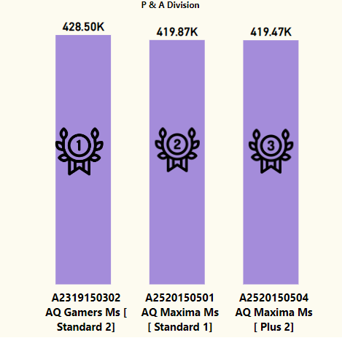
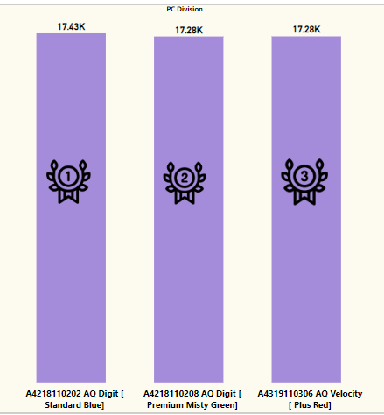
N & S Division
P & A Division
PC Division
[Standard 2] [Plus 2 ] [standard 1]
[Premium] ,
[Standard,]
[ Plus red]
[Premium] [Plus] [Premium]

Slide 17

THANK YOU
By Iffat Shaikh

Slide 18
with cte as
(select
p.product_code, division,concat(product,' [ ', p.variant,']') as product_variant,sum(s.sold_quantity) as total_sold_quantity,s.fiscal_year,row_number() over(partition by division order by sum(sold_quantity) desc) as rank_order
from
dim_product p
join
fact_sales_monthly s
using(product_code)
where
fiscal_year = 2021
group by
p.product_code, division,product_variant,fiscal_year)
Select
cte.division,
cte.product_code,
cte. product_variant,
cte.total_sold_quantity,
cte.rank_order
from cte
where rank_order <= 3 and division = "PC“
order by total_sold_quantity desc;

